Slide 1
INF 2202 IS Strategy, Management and Acquisition Lecture #5
Information Systems Strategies

Slide 2
Learning Objectives
Determine the role general managers must take in decisions about IS.
Define and explain the Information Systems Strategy Triangle.
Identify and define the various business strategy frameworks.
Explain the information system strategy matrix.
Understand and apply these models to different organizations.

Slide 3
Real World Example
During an ice storm in 2007 many airlines were cancelling flights.
Jet Blue waited to cancel flights and paid a heavy price.
Had to cancel 1,000 flights over 5 days.
Up to 9 planes full of passengers were stranded for up to 6 hours on the tarmac.
An inadequate reservation system and shoestring communication system was blamed for the problems by Neelman.
Changes had to be made.

Slide 4
The Impact of IS
Companies are out of alignment when their business strategy is not supported by their IS.
The Information Systems Strategy Triangle is a simple framework for understanding the impact of IS on organizations and proper alignment.
Successful firms have an overriding business strategy.
This business strategy drives both Organizational and Information strategy.
All decisions are driven by the firm’s business objectives.

Slide 5
The IS Strategy Triangle
Business Strategy
Information Strategy
Organizational Strategy

Slide 6
IS Strategy Triangle
Business Strategy drives all other strategies.
Organizational and Information Strategy are then dependent upon the Business Strategy.
Changes in any strategy requires changes in the others to maintain balance.
IS Strategy is affected by the other strategies a firm uses.
IS strategy always involves consequences.

Slide 7
Brief Overview Of Business Strategy Frameworks

Slide 8

Think about it
What is a business strategy?
Which factors influences a business strategy?
How does a business change its strategy without losing balance or becoming out of alignment?
Are there specific events that induce a business to change its strategies? What are they?

Slide 9
Strategy
A strategy is a coordinated set of actions to fulfill objectives, purposes and goals.
Strategy starts with a mission.
Figure (next slide) shows some example mission statements.
A business strategy is a plan articulating where a business seeks to go and how it expects to get there.
There are several “strategies” worth examining.

Slide 10
Mission statements of computer companies
IBM
At IBM, we strive to lead in the creation, development and manufacture of the industry's most advanced information technologies, including computer systems, software, networking systems, storage devices and microelectronics. We translate these advanced technologies into value for our customers through our professional solutions and services businesses worldwide.
DELL
Dell's mission is to be the most successful computer company in the world at delivering the best customer experience in markets we serve.
APPLE
Apple ignited the personal computer revolution in the 1970s with the Apple II and reinvented the personal computer in the 1980s with the Macintosh. Apple is committed to bringing the best personal computing experience to students, educators, creative professionals and consumers around the world through its innovative hardware, software and Internet offerings.

Slide 11
Generic Strategies Framework
Michael Porter describes how businesses can build a sustainable competitive advantage.
He identified three(3) primary strategies for achieving competitive advantage:
Cost leadership – lowest-cost producer.
Differentiation – product is unique.
Focus – limited scope.

Slide 12
Three strategies for achieving competitive advantage
Uniqueness Perceived by
Customer
Low Cost Position
Differentiation
Overall cost Leadership
Focus
Industry wide
Particular segment Only

Slide 13
Cost leadership Strategy
Porter's generic strategies are ways of gaining competitive advantage
In other words, developing the "edge" that gets you the sale and takes it away from your competitors.
There are two main ways of achieving this within a Cost Leadership strategy:
Increasing profits by reducing costs, while charging industry-average prices.
Increasing market share through charging lower prices, while still making a reasonable profit on each sale because you've reduced costs.

Slide 14
Cost leadership Strategy
Remember that Cost Leadership is about minimizing the cost to the organization of delivering products and services.
The cost or price paid by the customer is a separate issue!
The Cost Leadership strategy is exactly that – it involves being the leader in terms of cost in your industry or market.
Simply being amongst the lowest-cost producers is not good enough, as you leave yourself wide open to attack by other low-cost producers who may undercut your prices and therefore block your attempts to increase market share.

Slide 15
The Differentiation Strategy
Differentiation involves making your products or services different from and more attractive than those of your competitors.
How you do this depends on the exact nature of your industry and of the products and services themselves, but will typically involve features, functionality, durability, support, and also brand image that your customers value.

Slide 16
The Differentiation Strategy
To make a success of a Differentiation strategy, organizations need:
Good research, development and innovation.
The ability to deliver high-quality products or services.
Effective sales and marketing, so that the market understands the benefits offered by the differentiated offerings.

Slide 17
The Differentiation Strategy
Large organizations pursuing a differentiation strategy need to stay agile with their new product development processes.
Otherwise, they risk attack on several fronts by competitors pursuing Focus Differentiation strategies in different market segments.

Slide 18
The Focus Strategy
Companies that use Focus strategies concentrate on particular niche markets and, by understanding the dynamics of that market and the unique needs of customers within it, develop uniquely low-cost or well-specified products for the market.
Because they serve customers in their market uniquely well, they tend to build strong brand loyalty amongst their customers.
This makes their particular market segment less attractive to competitors.

Slide 19
Cost leadership Strategy
As with broad market strategies, it is still essential to decide whether you will pursue Cost Leadership or Differentiation once you have selected a Focus strategy as your main approach
Focus is not normally enough on its own.
But whether you use Cost Focus or Differentiation Focus, the key to making a success of a generic Focus strategy is to ensure that you are adding something extra as a result of serving only that market niche.

Slide 20
Cost leadership Strategy
It's simply not enough to focus on only one market segment because your organization is too small to serve a broader market (if you do, you risk competing against better-resourced broad market companies' offerings)

Slide 21
Hypercompetition
D'Aveni's 7S framework is Richard D'Aveni's approach to directing a firm in a high velocity or Hypercompetitive markets.
It is designed to enable firms sustain the momentum of their competitiveness through a series of initiatives that are poised to give temporary advantages rather than just structuring the firm to achieve internal or external fit aimed at maintaining equilibrium that are designed to sustain unsustainable competitive advantages

Slide 22
D’Aveni’s new 7 Ss
The 7 Ss are useful for determining different aspects of a business strategy and aligning them to make the organization competitive in the hypercompetitive arena.
The 7 Ss are :
1. Superior stakeholder satisfaction
2. Strategic soothsaying
3. Positioning for speed
4. Positioning for surprise
5. Shifting the rules of competition
6. Signaling strategic intent
7. Simultaneous and sequential strategic thrusts

Slide 23
D’Aveni’s new 7 Ss
Approach | Definition
Superior stakeholder satisfaction | Understanding how to maximize customer satisfaction by adding value strategically.
Strategic soothsaying | Seeking out new knowledge that can predict or create new windows of opportunity.
Positioning for speed | Preparing the organization to react as quickly as possible.
Positioning for surprise | Preparing the organization to respond to the marketplace in a manner that will surprise competitors.
Shifting the rules of competition | Finding new ways to serve customers which transform the industry.
Signaling strategic intent | Communicating the intended actions of a company, in order to stall responses by competitors.
Simultaneous and sequential thrusts | Taking a series of steps designed to shock and confuse competitors in order to disrupt or block their efforts.

Slide 24
Application of Hypercompetition
General Electric applied the Hypercompetition Model to its business units in the Destroy Your Business (DYB) project.
GE recognized that if they didn’t understand and recognize their own weaknesses they could not remain competitive.
Employees were tasked to determine ways to “destroy their business unit”. Once they have identified these areas of weakness they apply the Grow Your Business (GYB) strategy to find fresh ways to reach new customers and better serve existing customers.

Slide 25
IS Planning and Strategic Advantage Models
General Managers cannot afford to rely solely on IS personnel to make IS decisions.
Business strategy drives IS decision making.
Changes in IS potential should trigger business reassessments (i.e. the Internet).
Information Systems Strategy Triangle shows the proper balance of strategies.
The models are helpful in discussing the role of IS in building and sustaining competitive advantage.

Slide 26
Summary of key strategy frameworks
Framework | Key Idea | Application to Information Systems
Porter’s generic strategies Framework | Firms achieve competitive advantage through cost leadership, differentiation, or focus | Understanding which strategy is chosen by a firm is critical to choosing IS to complement the strategy
D’Aveni’s Hypercompetition Model | Speed and aggressive moves and countermoves by a firm create competitive advantage | IS are critical to achieving the speed needed for moves and countermoves. IS are in a constant state of flux or development.

Slide 27
Brief Overview Of Organizational Strategies

Slide 28
Organizational Strategy
Organizational strategy includes the organization’s design as well as the choices it makes in its work processes.
How will the company organize in order to achieve its goals and implement its business strategy?
Managerial Levers – another framework for organizational design, states that:
“Successful execution of the firm’s organizational strategy is the best combination of organizational, control, and cultural variables”

Slide 29
Business Diamond
Simple framework for identifying crucial components of an organization’s plan
its business processes
its values and beliefs
its management control systems
its tasks and structures.
Useful for designing new organizations and for diagnosing organizational troubles.

Slide 30
The Business Diamond
Business Process
Values and Beliefs
Management and Measurement Systems
Tasks and Structures

Slide 31
Managerial Levers
This framework (Figure next slide) suggests that the successful execution of a business’s organizational strategy comprises the best combination of organizational, control, and cultural variables.
Organizational variables include:
decision rights, business processes, formal reporting relationships, and informal networks.
Control variables include:
availability of data, nature and quality of planning, effectiveness of performance measurement and evaluation systems, and motivations to do good work.
Cultural variables comprise the values of the organization.

Slide 32
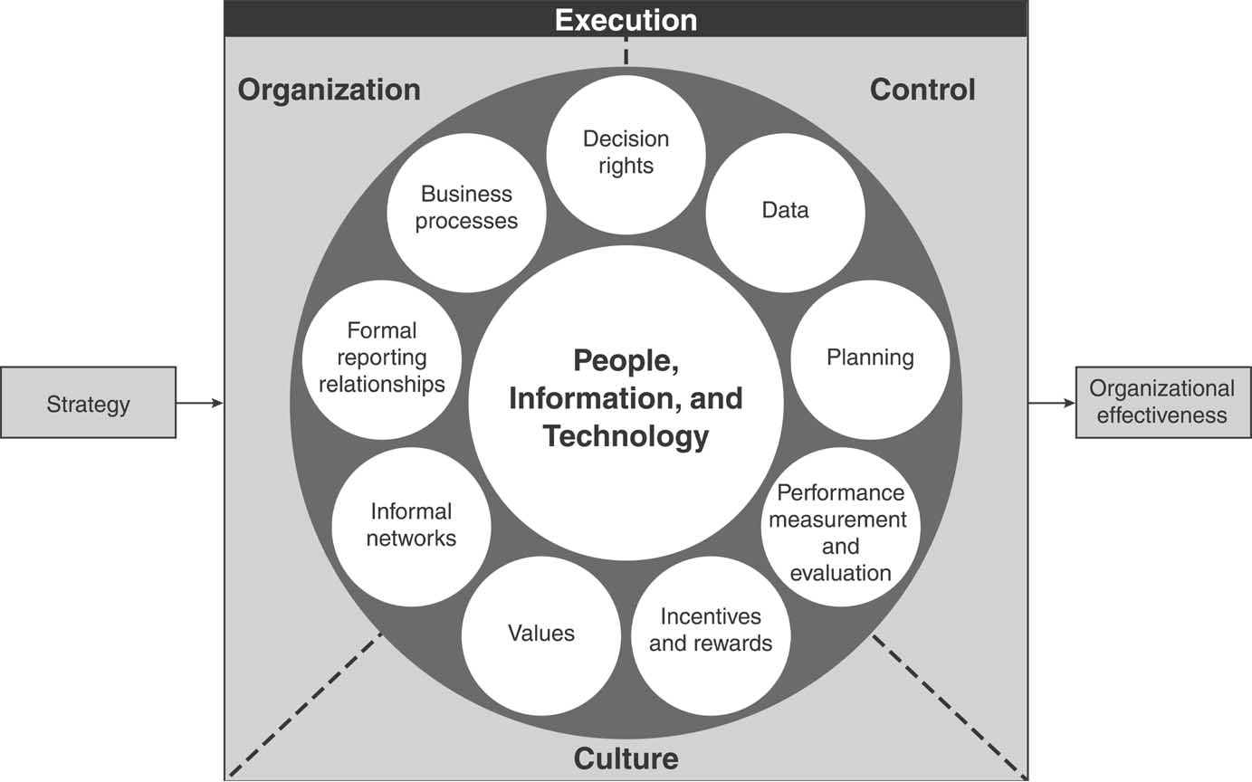
Managerial Levers

Slide 33
Understanding Organization Strategy
To understand organizational strategy we must answer the following questions:
1. What are the important structures and reporting relationships within the organization?
2. What are the characteristics, experiences, and skill levels of the people within the organization?
3. What are the key business processes?
4. What control systems are in place?
5. What is the culture of the organization?

Slide 34
Summary of organizational strategy frameworks
Framework | Key Idea | Usefulness in IS Discussions
Business Diamond | There are 4 key components of an organization: business processes, values and beliefs, management control systems, and tasks and structures. | Using IS in an organization will affect each of these components. Use this framework to identify where these impacts are likely to occur
Managerial levers | Organizational variables, control variables, and cultural variables are the levers managers can use to affect change in their organizations | This is a more detailed model than the Business diamond and gives specific areas where IS can be used to manage the organization and to change it

Slide 35
Brief Overview Of
Information Systems
Strategy

Slide 36
IS Strategy
The plan an organization uses in providing information services.
IS allows business to implement its business strategy.
IS helps determine the company’s capabilities.
Four key IS infrastructure components are key to IS strategy (see Figure next slide)
These key components are sufficient to allow the general manager to assess critical IS issues.

Slide 37
Information systems strategy matrix
 | What | Who | Where
Hardware | List of physical components of the system | Individuals who use it, Individuals who manage it | Physical location
Software | List of programs, applications, and utilities | Individuals who use it Individuals who manage it | What hardware it resides upon and where that hardware is located
Networking | Diagram of how hardware and software components are connected | Individuals who use it/ Individuals who manage it/ Company service obtained from | Where the nodes are located, where the wires and other transport media are located
Data | Bits of information stored in the system | Individuals who use it Individuals who manage it | Where the information resides

Slide 38
Food For Thought:
The Halo Effect And Other Business Misconceptions

Slide 39
Halo Effect
In Feb 2005 Dell was ranked #1 as the most admired company.
But, two years later their performance slumped.
The halo effect is “the basic human tendency to make specific inferences on the basis of a general impression” (Rosenzweig).
This effect impacted journalists view of Dell.

Slide 40
Halo Effect
Rosenzweig describes three misconceptions that are created by the halo effect in general
There exists a formula or blueprint that companies can apply and become high performers.
Firm performance is driven entirely by internal factors.
Because a decision may turn out badly does not necessarily mean that it was poorly made.

Slide 41
Halo Effect
Rosenzweig said that “managers should be doubtful of formulas, recognize that performance is relative, think of business decisions in terms of probabilities, and carefully evaluate decision making processes and not just their outcomes”.
Dell was not stuck in a rut and looked for new possibilities of growth.
HP hired a new CEO during that time period who was very effective and directly impacted Dell.

Slide 42
Summary
The Information Systems Strategy Triangle shows that business strategy always drives organizational and information strategies.
Business strategy drives organizational and IS strategy.
Includes models from Porter and D’Aveni.
Organizational strategy must complement business strategy.
Models are the business diamond and managerial levers.

Slide 43
Summary
IS strategy must complement business strategy.
When IS supports business goals the business appears to be working well.
Strategic Relationships.
Organizational strategy and information strategy must complement each other.
They must support, not hinder each other.
If change is made to one area the others must be examined to ensure balance.

